Slide 1

Christmas Sentiment Analysis
Intro to Data Science
Jerwin Carreon

Slide 2

Question:
What makes a Christmas merrier?

Slide 3

Points of idea
With Data Science I want to create the best Christmas for my family that would make them forget their problems/struggles for a while.
Does it have to do with the food to be served?
What food is best?
Does it have to do with the decorations?
What decorations to apply?
How?
Does it have to do with the activities?
What activities are best?
Is celebrating outside home is more effective?

Slide 4
Sentiments & analysis

Slide 5
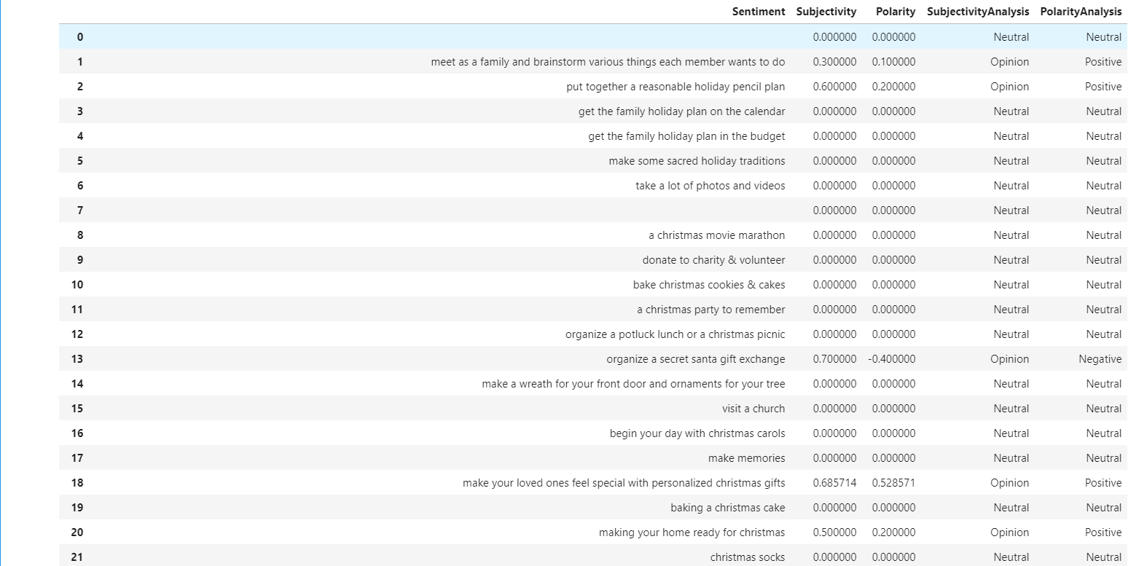

Slide 6
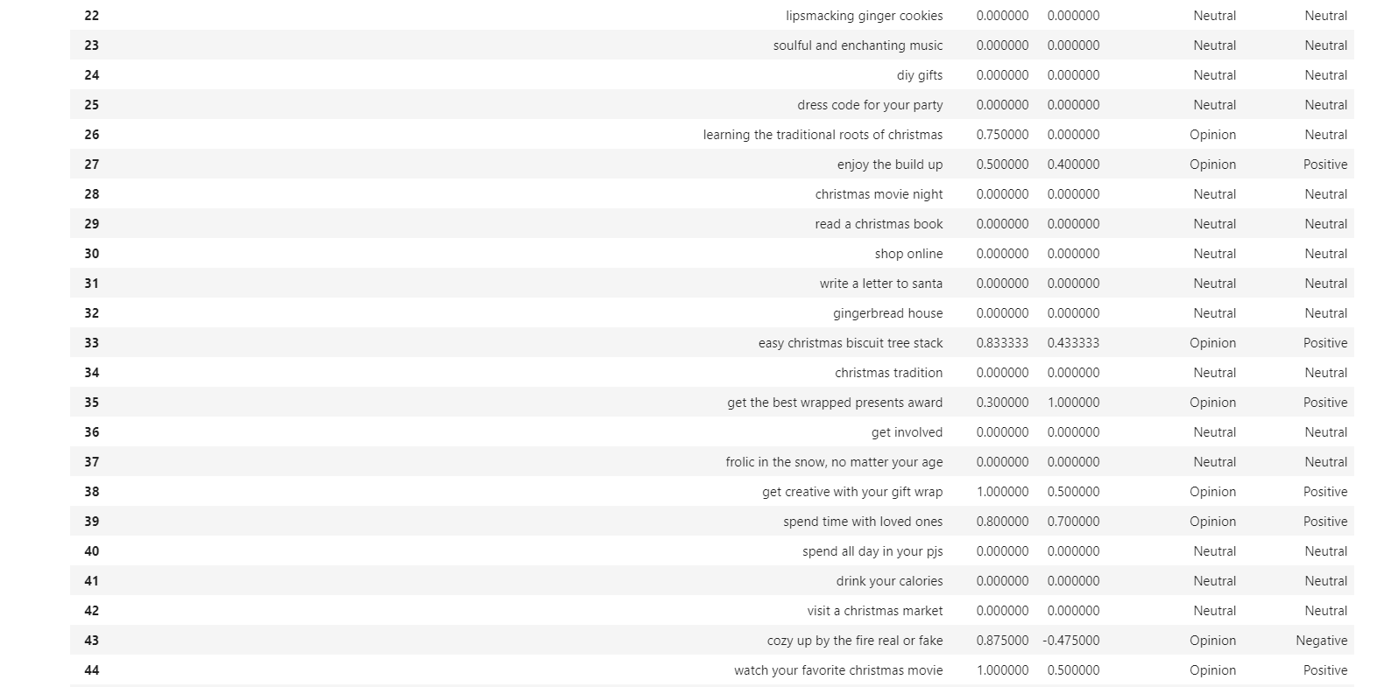

Slide 7
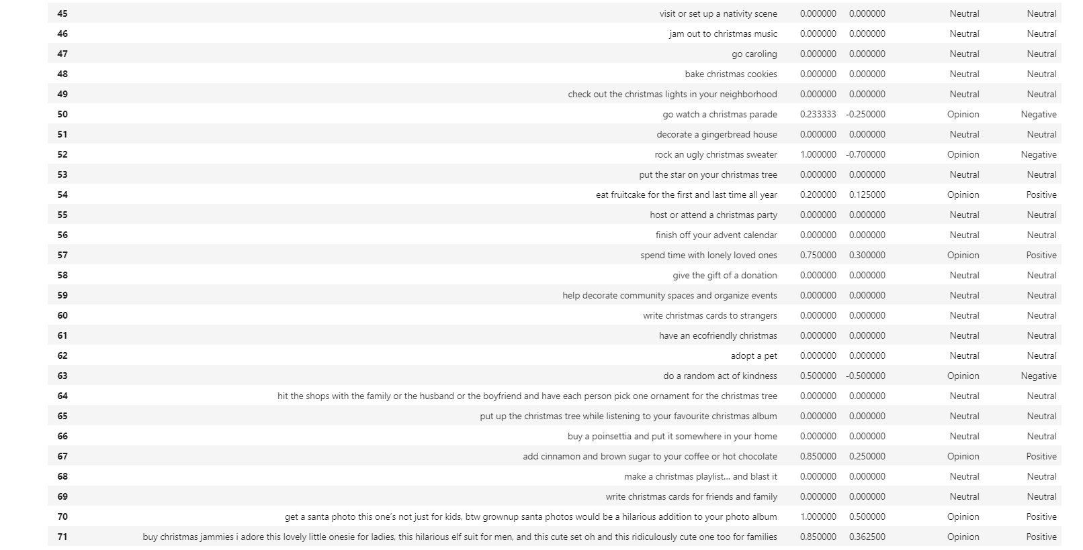

Slide 8
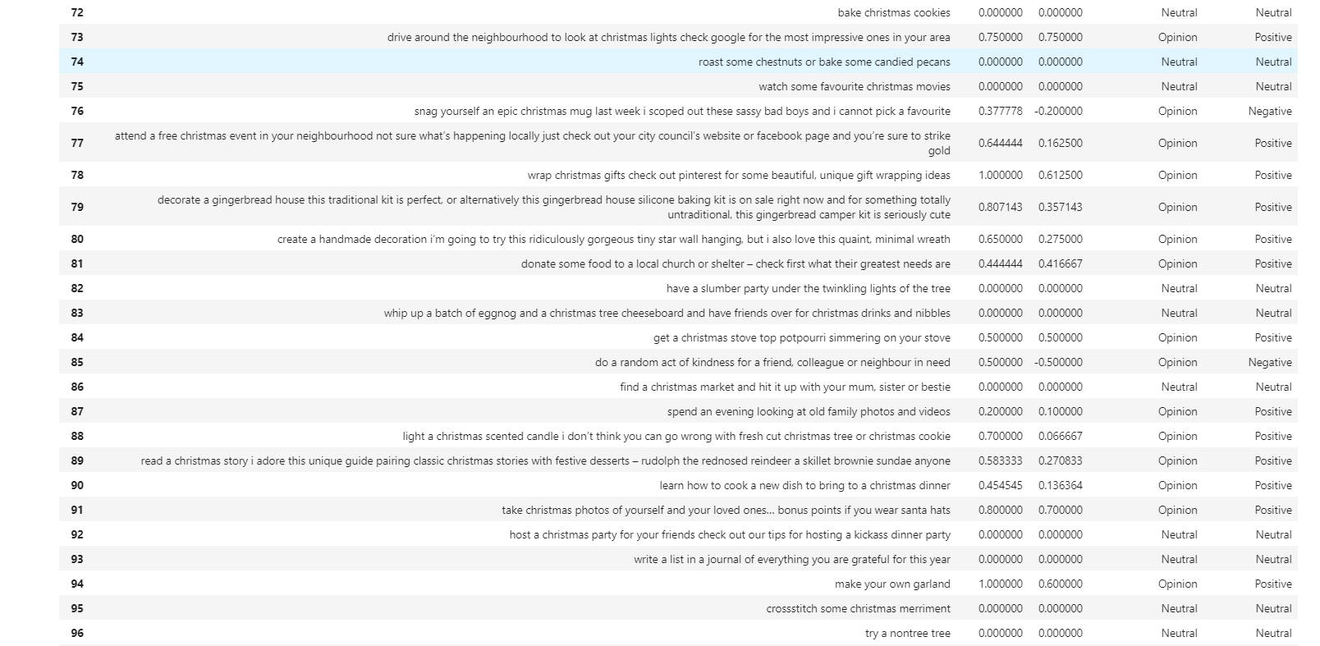

Slide 9
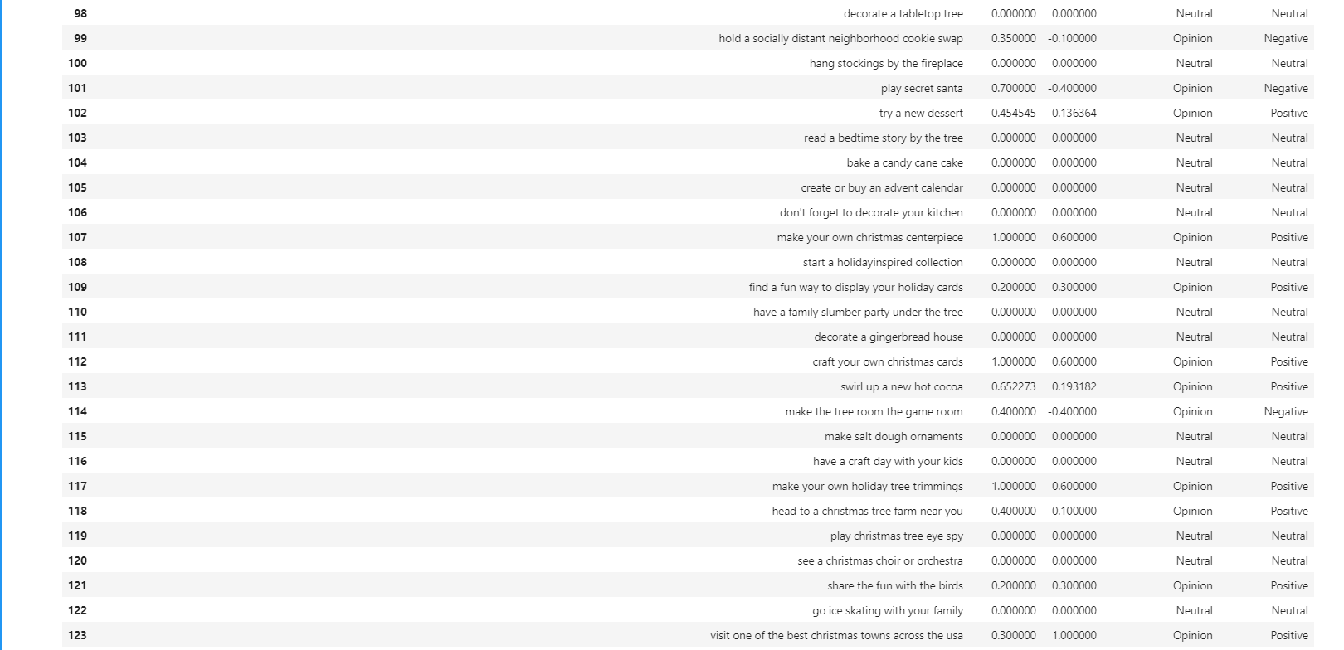

Slide 10
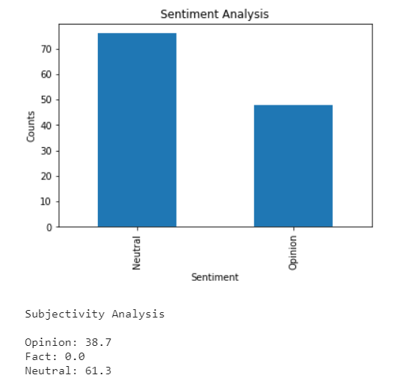
Subjectivity Analysis

Slide 11
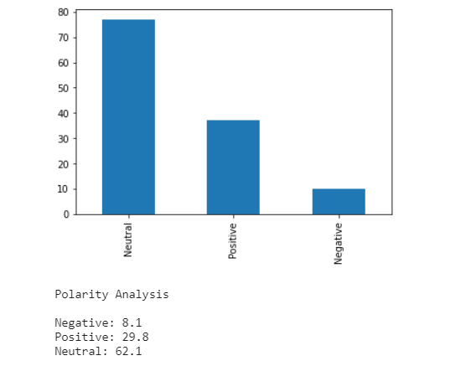
Polarity Analysis

Slide 12
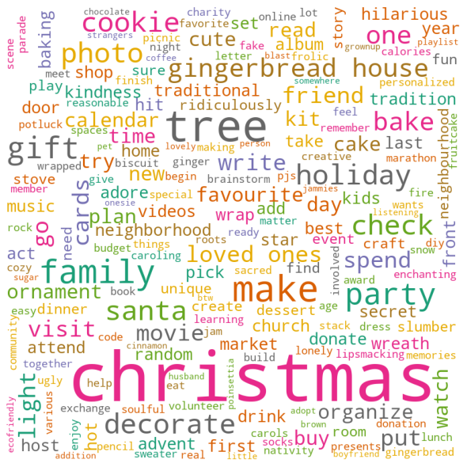
Word Cloud

Slide 13
Conclusion
According to the study, there is no facts for what makes Christmas merrier and everything is an opinion.
However combining all of the opinions I had found things that are repeatedly mentioned by different authors and with relevancy for what makes Christmas merrier. These things are listed below:
Christmas Tree
Family
Gifts
Decorate
Visit
House
Movie
Photo
Bake
So to make things that I could make the best Christmas for my family with these findings I could use it for a real help. This will be the foundation for next things that I would want to happen. Like “what makes a good Christmas Tree/Gift/Decoration?”

